Slide 1
Support Vector Machines - Part 1
UIUC ECON 490: Applied Machine Learning in Economics

Slide 2
Support Vector Machines
Why we like SVMs
Best “out of the box” classifier
Flexible decision boundaries
Can applied to regression problems
But computationally expensive!
Today: framework
Maximal Margin Classifier
Supper Vector Classifier

Slide 3

Maximal Margin Classifier
Uses a hyperplane to separate the data
“Hard margin classifier”
$$β_{0}+β_{1}x_{i1}+...+β_{p}x_{ip}=0$$
Another hyperplane…
$$\hat{y}=\hat{α}+{\hat{β}}_{1}x_{i1}+...+{\hat{β}}_{p}x_{ip}$$
$$0=(\hat{α}−\hat{y})+{\hat{β}}_{1}x_{i1}+...+{\hat{β}}_{p}x_{ip}$$
Scale matters!

Slide 4
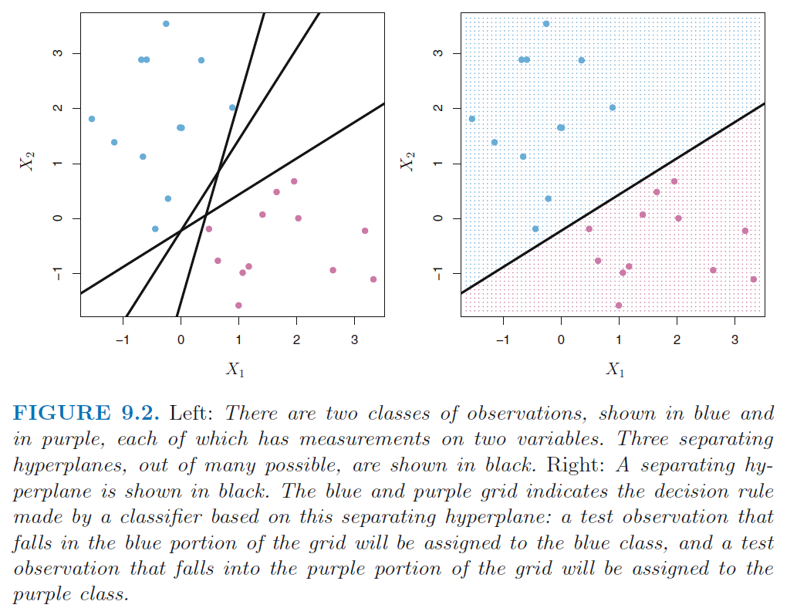
Fitting the “Widest Street”

Slide 5
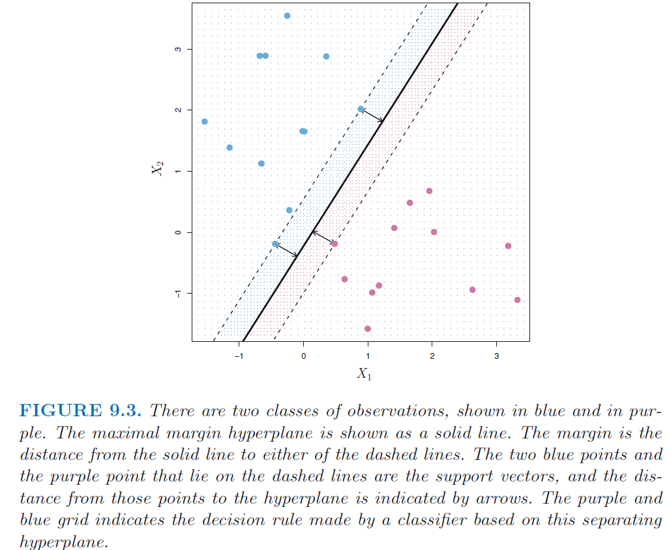
Fitting the “Widest Street”

Slide 6

Maximal Margin Classification
Under the hood: encoding $y=\{−1,1\}$
If sampled data $x_{i}^{∗}$ below the hyperplane, predict $−1$
If above hyperplane, predict group $1$
Two limitations…

Slide 7
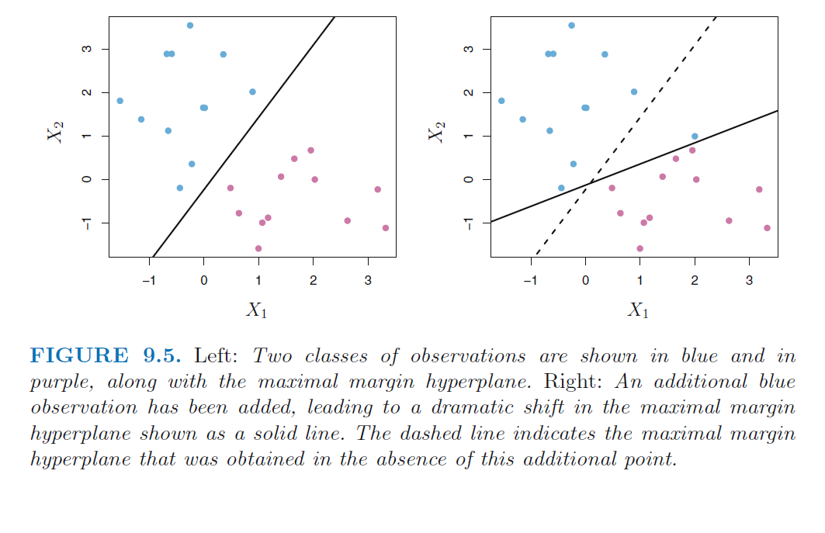
Sensitive to outliers

Slide 8
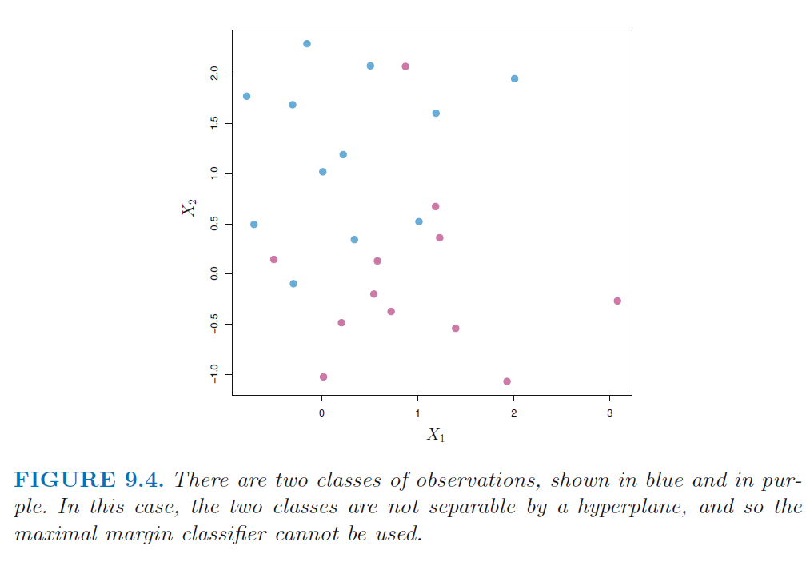
Cannot Fit Non-separable Data

Slide 9
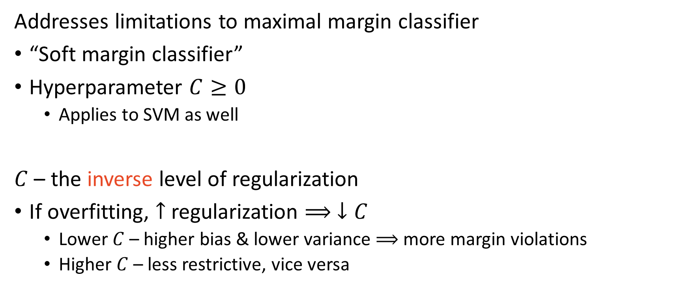
Support Vector Classifier
Addresses limitations to maximal margin classifier
“Soft margin classifier”
Hyperparameter $C≥0$
Applies to SVM as well
$C$ – the inverse level of regularization
If overfitting, $↑$ regularization $⟹ ↓C$
Lower $C$ – higher bias & lower variance $⟹$ more margin violations
Higher $C$ – less restrictive, vice versa

Slide 10
How to determine $C$?
Cross-validation!!
What is CV doing?
Finding a finite sample “optimum” balance of the BV tradeoff

Slide 11
To Do
Read 9.3, 9.4, and 9.5

